Slide 1
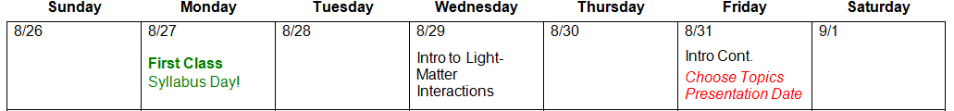
1 down, 38 to go
You are here.
Absorption (2)
Circular Dichroism (1)
Fluorescence (1)
Time-resolved Emission (2)
Transient Absorption (2)
Quantum yield (2)
Cyclic Voltammetry (1)
Other Echem (2)
Infrared Absorption (1)
Raman Spectroscopy (1)
Electrochemical Impedance (1)
Solar cell testing (IV, IPCE, etc.) (1)
Thermogravametric Analysis (1)
Differential scanning calorimetry (1)
Dynamic Light Scattering (1)
BET Surface Area Analysis (1)
Mossbauer Spectroscopy (1)
Have a backup!

Slide 2
Homework + Presentation (150 points)
1) Pick an instrument/technique discussed in class
2) Presentation (50 pts):
Give a >20 min talk on a paper that focuses on the technique. Peer feedback?
3) Homework 1 (50 pts):
Write 2 multiple choice, 2 true/false, and 1 short answer questions about your technique/paper.
4) Homework 2 (50 pts):
Design an interactive science museum exhibit that explains your technique to children.

Slide 3
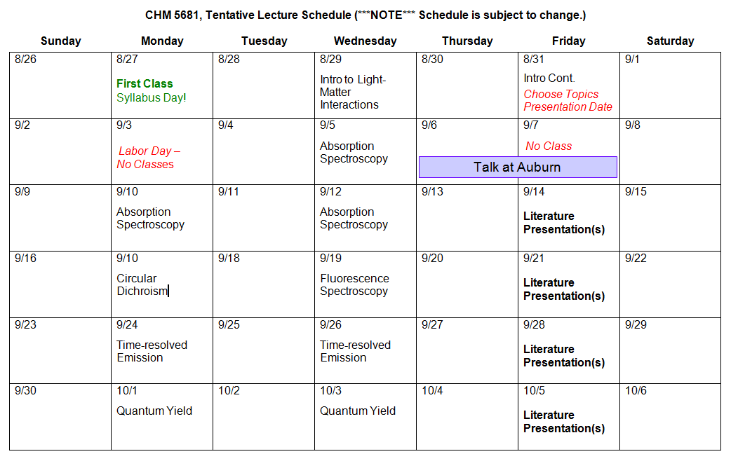
2 x Absorption
CD + Fluor.
2 x TRES
2 x QY

Slide 4
CHM 5681
Introduction to Photophysics

Slide 5
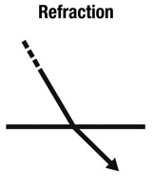
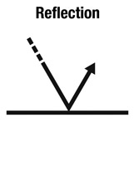
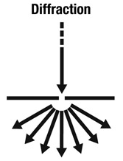
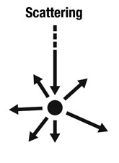
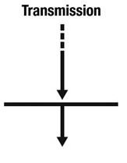
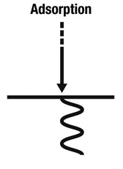
Interaction of Incident Light with Matter

Slide 6

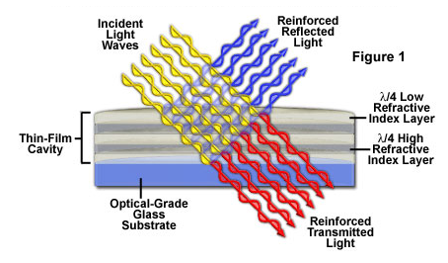
Interaction of Incident Light with Matter
Rainbows
Mirage
Moon Light
Most solids
Two-slit exp
Holograms
Shadow Blur
Sand in Water
Sunsets
DLS
Raman

Slide 7
Interaction of Incident Light with Matter
Rainbows
Mirage
Moon Light
Most solids
Two-slit exp
Holograms
Shadow Blur
Sand in Water
Sunsets
UV-Vis
Fluorometry
TRE, TA

Slide 8
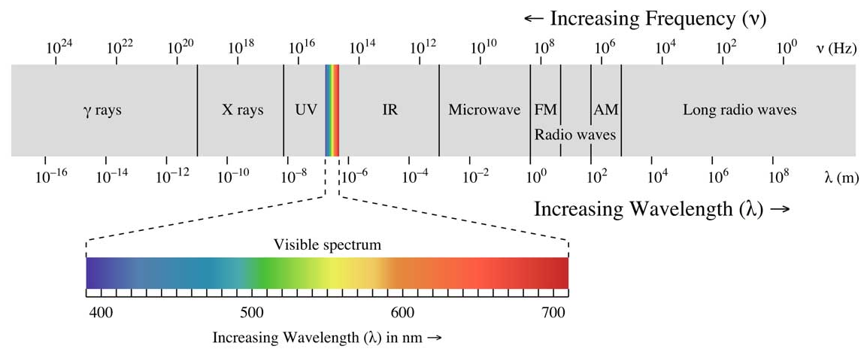
Interaction of Light with Matter
Narrowing our focus
Absorp./Trans.
Visible spectrum
Electronic Transitions- electrons excited from one energy level to another.
Atomic
Molecular
Materials
Solids
Light (hν)
Sample

Slide 9
Hydrogen Absorption
hν
Energy
hν
Ground State
Excited State

Slide 10
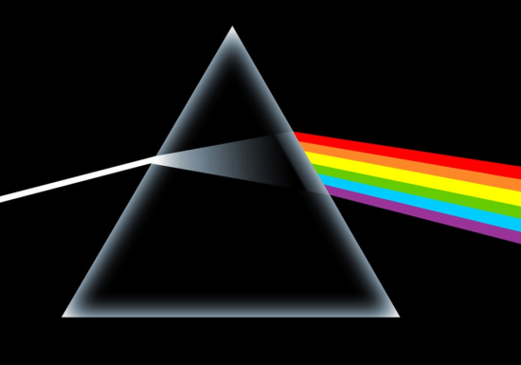
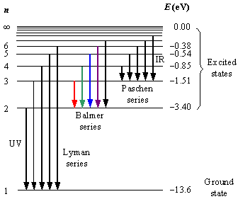
Hydrogen Absorption
H
H
H
H
H
H
H
“white” light source
Hydrogen Sample
Prism
Line Spectrum
Rydberg Formula

Slide 11
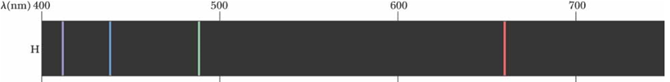
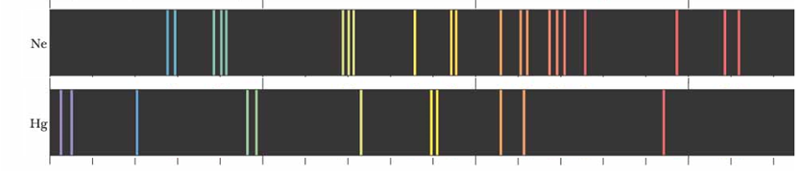
Increasing Complexity
1 e⁻
10 e⁻
80 e⁻
Atomic Transitions
(movement of electrons)
+
Molecular/Materials Transitions
(movement of electron density)
250 e⁻

Slide 12
Transitions
hν
hν
Hydrogen Transitions
hν
hν
>H Transitions

Slide 13
The following is a preview for group theory.

Slide 14


Transition Moment
The transition probability from one state (Ψ₁) to another state (Ψ₁) is given by |M⃗₂₁|, the transition dipole moment, or transition moment, from Ψ₁ to Ψ₂.
Transition moment:
S₂
S₁
Ψ₂
Energy
S₀
Ψ₁
where μ⃗ is the electric dipole moment operator:
where Q_{n} is charge, x⃗ n is the position vector operator.
For an electronic transition to be allowed, the transition moment integral must be nonzero.

Slide 15
Transition Moment
ε ≈
If M⃗₂₁ = 0, then the transition probability is 0 and the transition from Ψ₁ to Ψ₂ is “forbidden” or electric-dipole “forbidden.”
If M⃗₂₁ ≠ 0, then the transition probability is not 0 and the transition from Ψ₁ to Ψ₂ is not “forbidden.”
M⃗₂₁ = 0, ε = 0
M⃗₂₁ ≠ 0, ε ≥ 0
Does not tell you definitively that it is allowed or how intense it will be. Only that it is not electric-dipole forbidden.

Slide 16
Transition Moment
ε ≈
x
Ψ₁
Ψ₂
hν
hν

Slide 17



Transition Moment
Ψ₁
Ψ₂
allowedness of a transition
=
Irr. Rep. for the excited state
Irr. Rep. for the
linear basis
(x, y, and z)
Irr. Rep. for the ground state
hν
If the direct product DOES NOT contain the totally symmetric representation (A, A1, A1g…), then the transition is FORBIDDEN by symmetry arguments.
If the direct product DOES contain the totally symmetric representation (A, A1, A1g…), then the transition is ALLOWED by symmetry arguments.
The integral will be exactly zero if the Irr. Rep. of the direct product does not contain A, A₁, A_{g} , A_{1g} or A’.

Slide 18
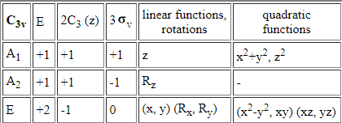
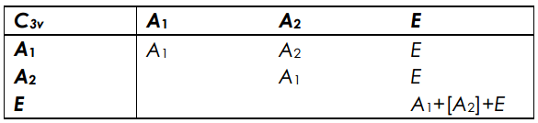

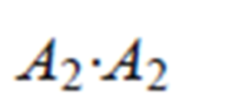





Direct Product Table
allowedness of a transition
=

Slide 19
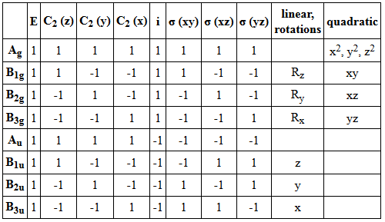
Example (d_{z2} to p_{z})
allowedness of a transition
=
Irr. Rep. for the excited state
Irr. Rep. for the ground state
Irr. Rep. for the
linear basis
(x, y, and z)
(z)
(x)
(y)
p
(pz)
D_{2h}
B_{1u}
B_{3u}
B_{2u}
B_{1u}
B_{1u}
hν
s
A_{g}
(z²)
(xy)
(xz)
(yz)
(x²-y²)
d
(dz²)
A_{g}
B_{1g}
B_{2g}
B_{3g}
A_{g}
A_{g}
A_{g}

Slide 20

Example (d_{z2} to p_{z})
Forbidden
(p_{z})
x basis
B_{1u}
B_{3u}
A_{g}
=
B_{2g}
B_{1u}
B_{1u}
Forbidden
y basis
B_{1u}
B_{2u}
A_{g}
=
B_{3g}
hν
Allowed
z basis
B_{1u}
B_{1u}
A_{g}
=
A_{g}
(d_{z2})
A_{g}
A_{g}
The transition is forbidden if the direct product does not contain A, A₁, A_{g} , A_{1g} or A’.
The transition is allowed if the direct product does contains A, A₁, A_{g} , A_{1g} or A’.
z polarized = allowed
hν
x polarized = forbidden
hν
d_{z2}
p_{z}
y polarized = forbidden
Allowed

Slide 21
End of preview.

Slide 22
Types of Molecular Transitions
σ - σ*
λ_{max} < 150 nm
π - π*
λ_{max} 200 - 800 nm
n - π*
λ_{max} 150 - 300 nm

Slide 23
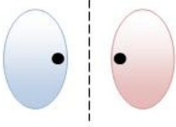

Types of Molecular Transitions
Ozone!
σ - σ*
λ_{max} < 250 nm
High energy photons
    methane = 125 nm
    ethane = 135 nm
Antibonding
hν
Bonding
Ground State
Excited State

Slide 24
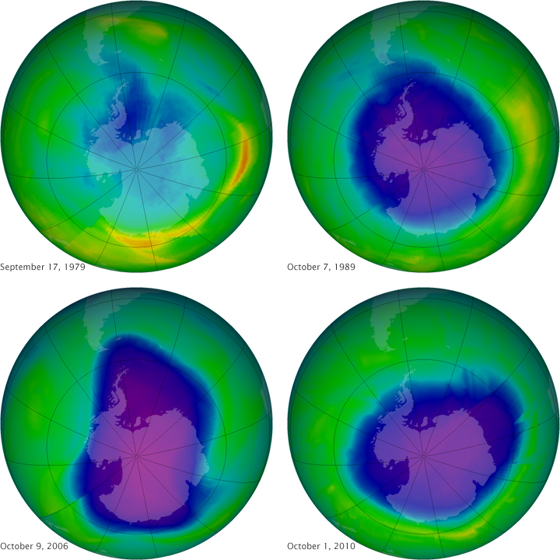
Ozone and Photocatalysis
1950s-70s CFCs wide spread use in refrigerators.
1960s and 70s scientists observe a depletion in the ozone layer.
Mid 70s scientists propose a catalytic mechanism for the
hν
CCl₂F₂ → Cl• + •CClF₂
O₃ + Cl• → ClO• + O₂
ClO• + O → O₂ + Cl•
1996- CFC production ends in US and Europe
2010-for the first time in decades the ozone concentration is increasing

Slide 25
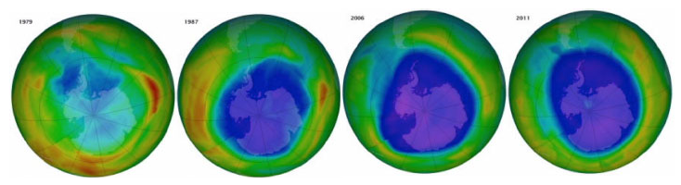
“Give me a little spray. … You know you’re not allowed to use hairspray anymore because it affects the ozone, you know that, right? I said, you mean to tell me, cause you know hairspray’s not like it used to be, it used to be real good. … Today you put the hairspray on, it’s good for 12 minutes, right. … So if I take hairspray and I spray it in my apartment, which is all sealed, you’re telling me that affects the ozone layer? “Yes.” I say no way folks. No way. No way. That’s like a lot of the rules and regulations you people have in the mines, right, it’s the same kind of stuff.”

Slide 26

“Give me a little spray. … You know you’re not allowed to use hairspray anymore because it affects the ozone, you know that, right? I said, you mean to tell me, cause you know hairspray’s not like it used to be, it used to be real good. … Today you put the hairspray on, it’s good for 12 minutes, right. … So if I take hairspray and I spray it in my apartment, which is all sealed, you’re telling me that affects the ozone layer? “Yes.” I say no way folks. No way. No way. That’s like a lot of the rules and regulations you people have in the mines, right, it’s the same kind of stuff.”
-Donald Trump
May 5, 2016

Slide 27
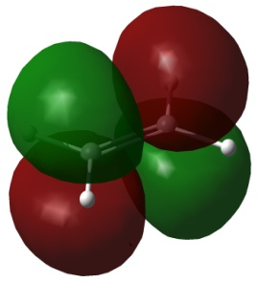
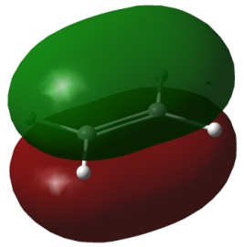
Types of Molecular Transitions
π - π*
λ_{max} 200 - 800 nm
Visible photons
    benzene = 260 nm
    tetracene = 500 nm
Antibonding
hν
Bonding
Ground State
Excited State

Slide 28
Types of Molecular Transitions
n - π*
λ_{max} 150 - 300 nm
Visible photons
    acetone = 280 nm
    pyridine = 270 nm
Antibonding
hν
Non-Bonding
Ground State
Excited State

Slide 29
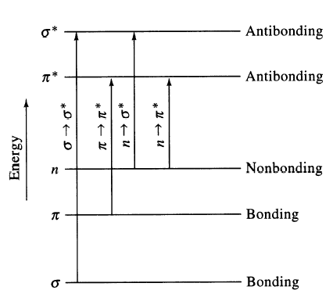
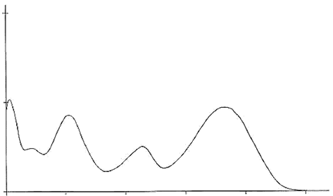
Types of Molecular Transitions
σ - σ*
λ_{max} < 150 nm
π - π*
λ_{max} 200 - 800 nm
σ - σ*
π - π*
Absorption
n - π*
λ_{max} 150 - 300 nm
n - π*
100
200
300
400
500
Wavelength (nm)

Slide 30
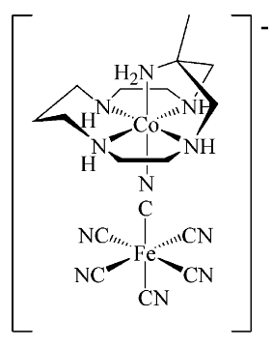
Types of Molecular Transitions
[Co(H₂O)₆]²⁺
Metal Centered (MC)
λ_{max} 200 –800 nm
MnO₄⁻
MLCT
λ_{max} 300 –1000 nm
LMCT
λ_{max} 300 –1000 nm
MMCT
λ_{max} 300 –800 nm

Slide 31
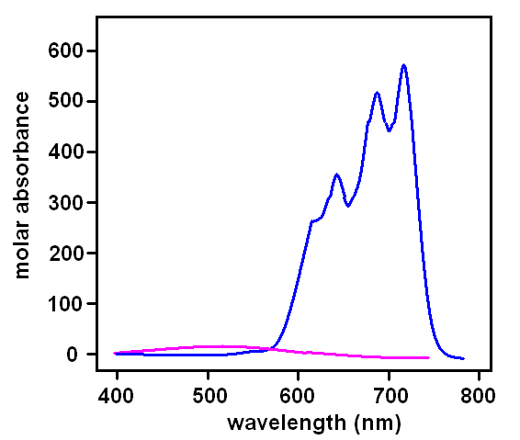
Types of Molecular Transitions
Metal Centered (MC)
d-d transitions
λ_{max} 200 – 800 nm
e_{g}
t_{2g}
[CoCl₄]²⁻
M
M + L
3d and 4d transition metals (+ ligands)
Relatively weak (0-1000 M⁻¹cm⁻¹)
Early structural determination
[Co(H₂O)₆]²⁺

Slide 32
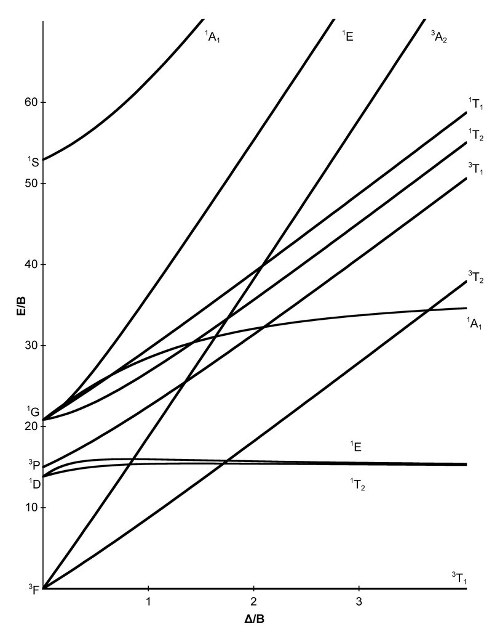
Tanabe-Sugano Diagrams
d³
Useful for:
Electronic States
Relative Energies
Ligand Field Affects
Optical Transitions
Spin Multiplicities
High-Spin to Low-Spin Transitions
Estimate Δ_{o}

Slide 33
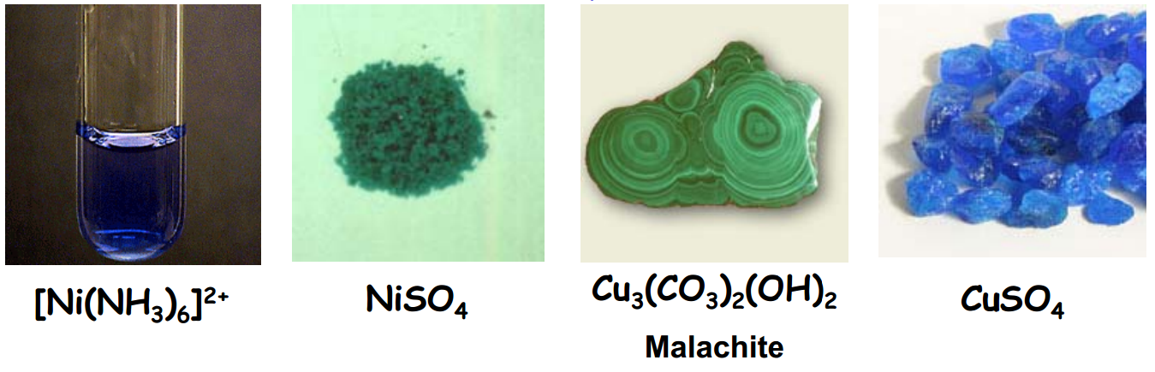
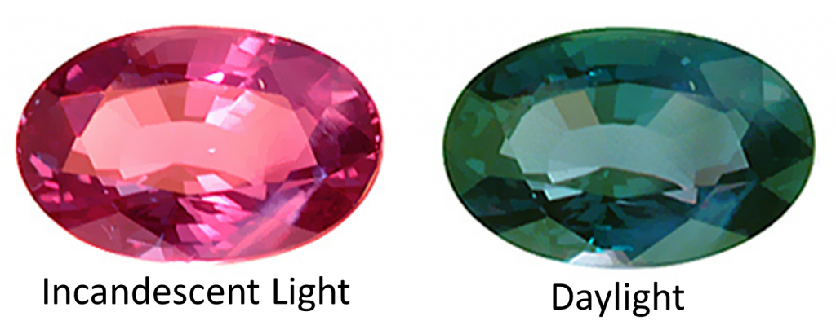
Colors of Metal Ions
Alexandrite
Cr³⁺ doped
BeAl₂O₄

Slide 34
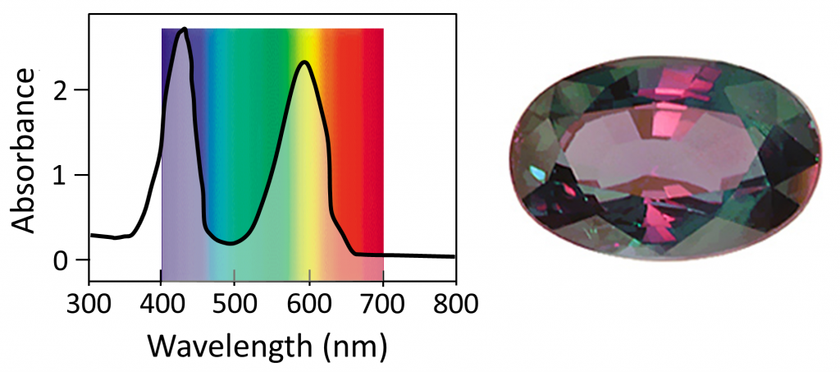
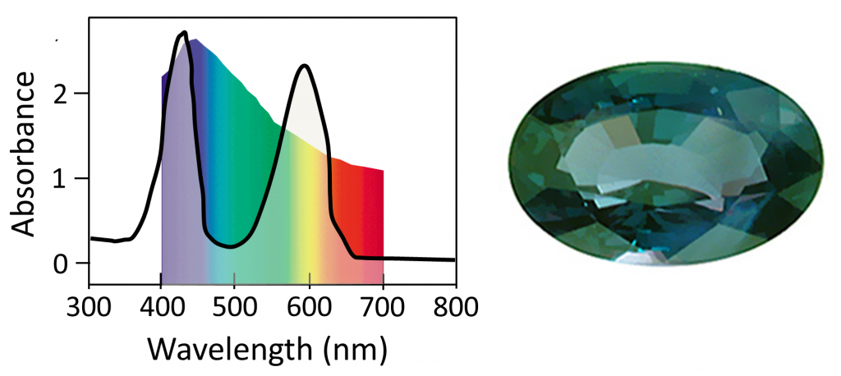
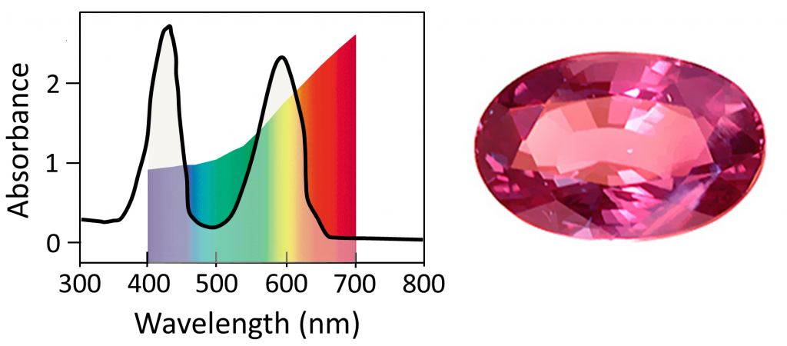
Colors of Metal Ions
Cr³⁺ doped
BeAl₂O₄
Uniform White Light
~400 nm = ⁴A_{2g} to ⁴T_{1g}
~600 nm = ⁴A_{2g} to ⁴T_{2g}
Sunlight
Candle Light
http://www.chemistry-blog.com/2013/08/22/alexandrite-effect-not-all-white-light-is-created-equal/

Slide 35
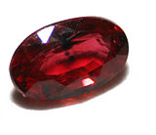
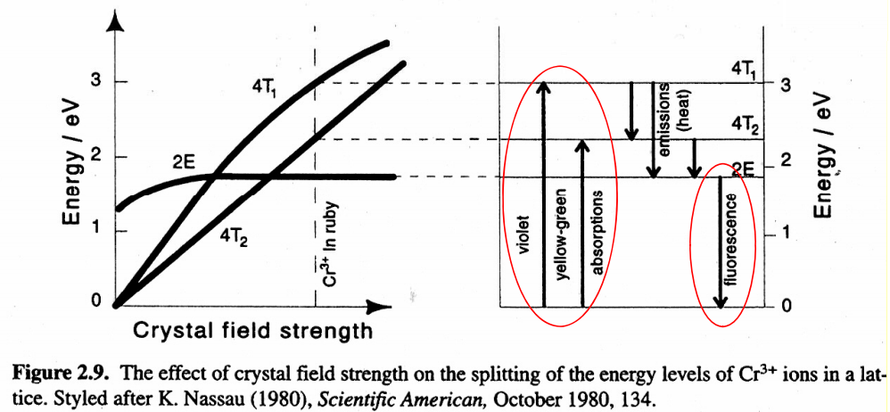
Colors of Metal Ions
Ruby
~1% Cr³⁺ doped Al₂O₃
Absorbs yellow-green region
Emits red
Most expensive ruby (1.6 cm³) = $6.7 million
Al₂O₃ (1.5 cm³) = ~$500

Slide 36
Types of Molecular Transitions
Metal-to-Ligand Charge Transfer (MLCT)
λ_{max} 300 – 1000 nm
e_{g}
e⁻
π*
hν
t_{2g}
π - π*
M
M + L
L
MLCT
  Low-lying empty ligand orbital
  Low oxidation state metal (electron rich)
  High d orbital energy

Slide 37
Types of Molecular Transitions
Ligand-to-Metal Charge Transfer (LMCT)
λ_{max} 300 – 1000 nm
e⁻
e_{g}
Mn-O₄⁻
O²⁻ (π) → Mn⁷⁺
Purple
t_{2g}
π
e⁻
Cd-S
S²⁻ (π) → Cd²⁺
Yellow
M
M + L
L
  Ligand with high E lone pairs (S or Se)
  Metal with low-lying empty orbitals

Slide 38
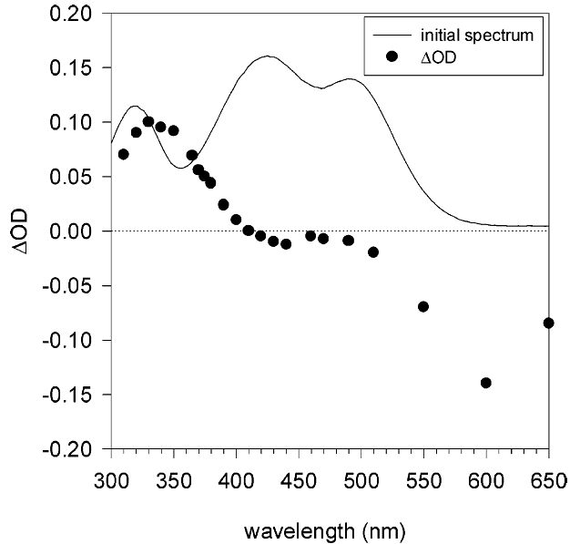
Types of Molecular Transitions
Metal-to-Metal Charge Transfer (MMCT)
λ_{max} 300 – 800 nm
III
e⁻
II
MMCT
e_{g}
e_{g}
t_{2g}
M¹
M²
t_{2g}
M¹ + L
M² + L

Slide 39
Types of Molecular Transitions
π∗
e⁻
e⁻
e_{g}
e⁻
e_{g}
M¹
t_{2g}
M²
t_{2g}
MLCT
π
MC
Absorption
LMCT
M¹ + M² + L
MMCT
300
400
500
600
700
Wavelength (nm)

Slide 40
Complete Diagram
Transitions
σ - σ*
E₂
σ - π*
n - π*
π - π*
Transitions
n - π*
Electronic
n - σ*
Energy
E₁
MLCT
MC
MLCT
LMCT
MMCT
E₀

Slide 41
Complete Diagram
Transitions
σ - σ*
E₂
σ - π*
n - π*
π - π*
Transitions
n - π*
Electronic
n - σ*
Energy
E₁
Vibrational
MLCT
Rotational
MC
MLCT
LMCT
MMCT
E₀

Slide 42
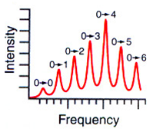
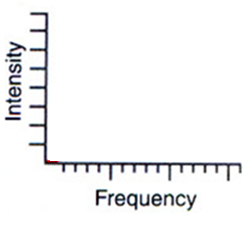
Vibronic Structure
Transitions
Electronic
cool
Δ
Energy
E₁
Vibrational
E₀

Slide 43
Vibronic Structure
Transitions
Electronic
Energy
E₁
Vibrational
MLCT
E₀

Slide 44
Complete Diagram
Jablonski Diagram
S₂
E₂
S₁
Energy
Transitions
Electronic
Energy
E₁
Vibrational
S₀
Rotational
E₀

Slide 45
Complete Diagram
Jablonski Diagram
S₂
S₁
Second Excited State (S₂)
Energy
First Excited State (S₁)
S₀
Excitation
Internal Conversion
Fluorescence
Ground
State (S₀)
Non-radiative decay

Slide 46
Complete Diagram
Jablonski Diagram
S₂
hν
S₁
Energy
Ground State
S₀
Singlet Excited State
S₁
S₀
Excitation
Internal Conversion
Fluorescence
Non-radiative decay

Slide 47
Triplet/Singlet Excited States
Nicholas J. Turro, Principles of Molecular Photochemistry

Slide 48
Spin-Orbit Coupling

Slide 49
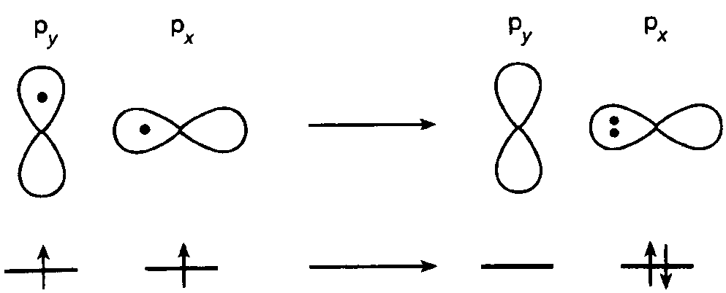
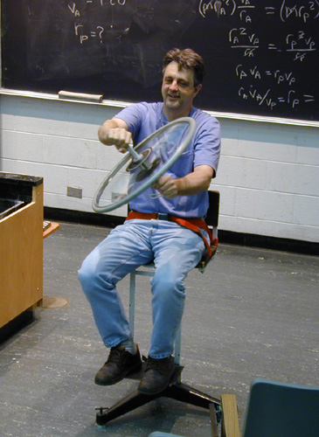
Spin-Orbit Coupling
Quantum Numbers
n = Principal
l = Angular
m_{l} = Magnetic
m_{s} = Electron spin
Heavy Atoms
Pt, Ir, I...
Rotating Chair and Bicycle Wheel
Nicholas J. Turro, Principles of Molecular Photochemistry

Slide 50
Jablonski Diagram
S₂
Excitation
Internal Conversion
Fluorescence
Non-radiative decay
Intersystem Crossing
Phosphorescence
S₁
T₂
Energy
T₁
S₀

Slide 51
Jablonski Diagram of Anthracene
Nicholas J. Turro, Principles of Molecular Photochemistry

Slide 52
Other Processes
S₂
S₁
T₂
Energy
T₁
Electron transfer
TICT
ESIPT
Photochemical
  Reactions
S₀
Excitation
Internal Conversion
Fluorescence
Non-radiative decay
Intersystem Crossing
Phosphorescence

Slide 53
Excited State Electron Transfer
e⁻
hν
e⁻
+
A
Ru^{III}(bpy)₃ + A⁻
e⁻
hν
+
+
Ru^{II}(bpy)₃
[Ru^{II}(bpy)₃]*
A
Ru^{III}(bpy)₃
A⁻

Slide 54
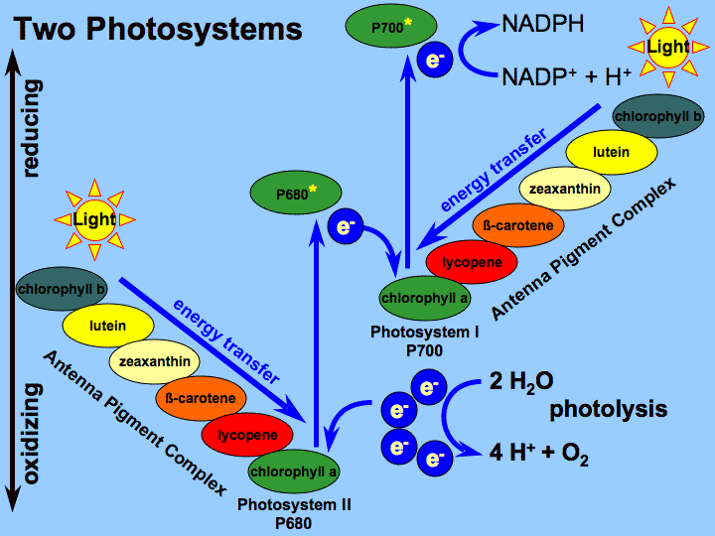
Excited State Electron Transfer
Photosynthesis

Slide 55
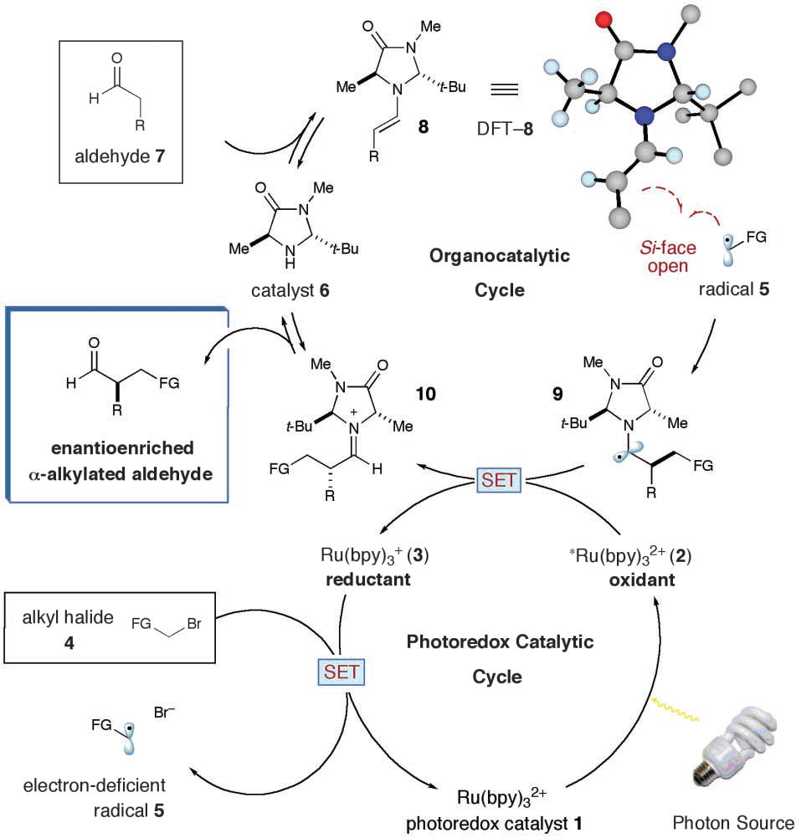
Excited State Electron Transfer
Photocatalytic α-alkylation of aldehydes
Nicewicz, D. A.; MacMillan, D. W. C. Science 2008, 322, 77-80.

Slide 56
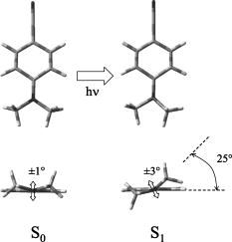
Excited State Structural Change
Twisted Intramolecular Charge Transfer
e⁻
e⁻
Pratt et al. J. Chem. Phys. 2005, 122, 084309

Slide 57


Excited State Structural Change
Excited State Proton Transfer
ESIPT
absorption
reverse proton transfer
emission

Slide 58
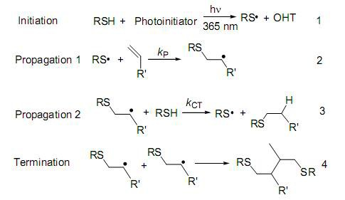
Photochemical Reactions
Photopolymerization

Slide 59
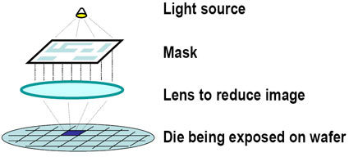
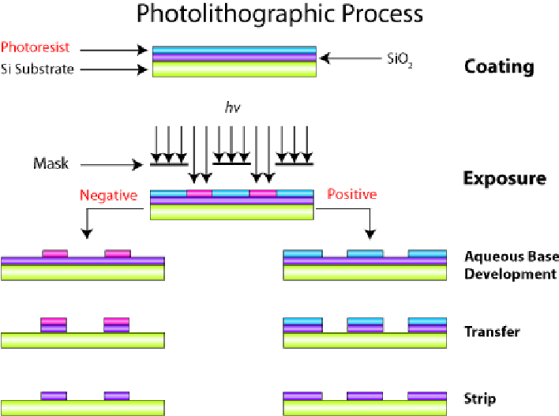
Photochemical Reactions
Photolithography

Slide 60
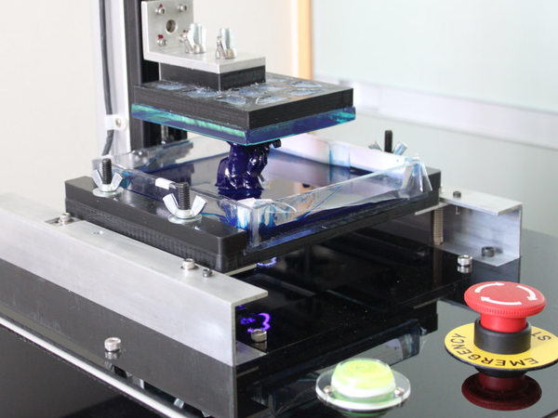
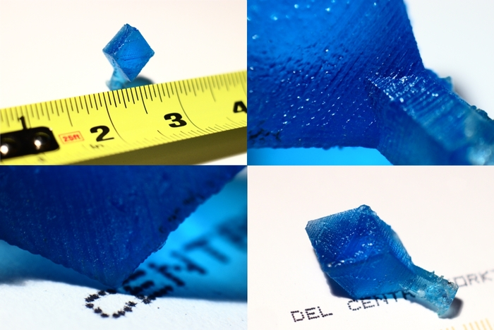
Photochemical Reactions
Photopolymerization
3-D Printers

Slide 61
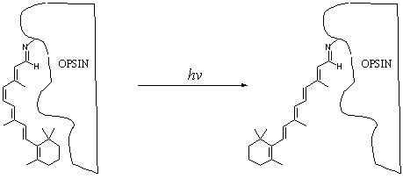
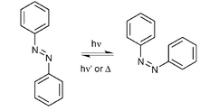

Photochemical Reactions
Photoisomerization
hν
Ground State
Excited State

Slide 62



Photochemical Reactions
Photoswitches
J. Am. Chem. Soc., 2013, 135 (16), pp 5974–5977

Slide 63
“Complete” Jablonski Diagram
S₂
Product
S₁
T₂
E
T₁
Product
S₀
Processes
Excitation
Fluorescence
Phosphorescence
Non-radiative decay
Internal conversion
Intersystem crossing
Photochemistry
Measurement Technique
Absorption Spectroscopy
Fluorescence Spectroscopy
Transient Absorption Spectroscopy

Slide 64






Side Note: Other Excitations
Thermal Excitation

Slide 65





Side Note: Other Excitations
Chemical Excitation

Slide 66



Side Note: Other Excitations
Sonoluminescence

Slide 67





Side Note: Other Excitations
  Tribo/Fractoluminescence
Nature 2008, 455, 1089–1092.

Slide 68




Side Note: Other Excitations
  Electroluminescence

Slide 69
Photophysics End
Any Questions?

